Slide 1
Sliding Window Protocols

Slide 2
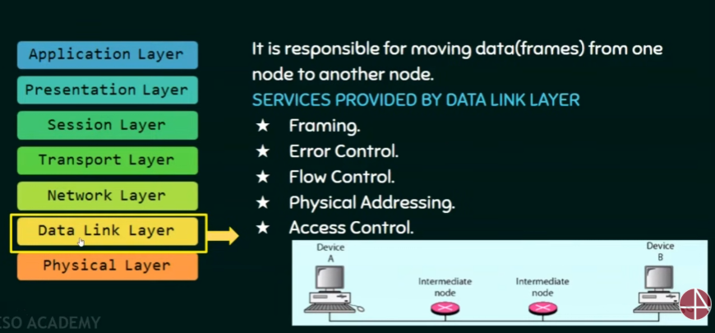
Flow Control

Slide 3
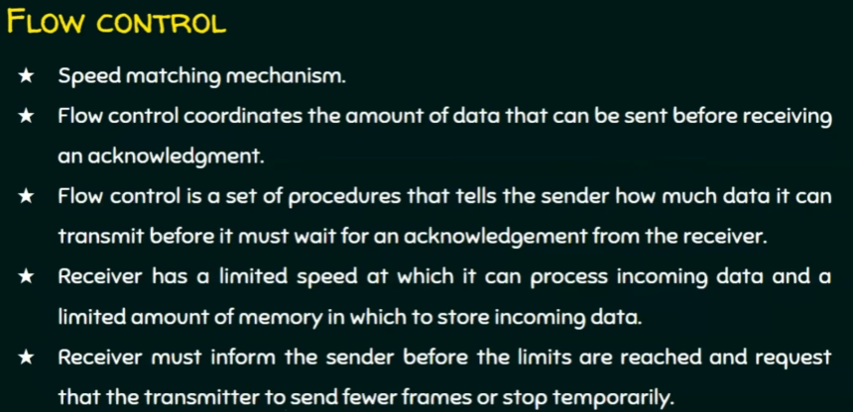
Flow Control

Slide 4
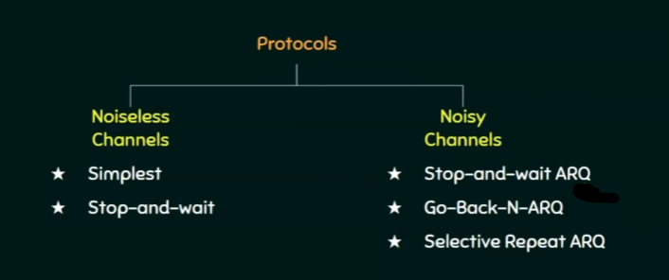
Flow Control - Protocols

Slide 5
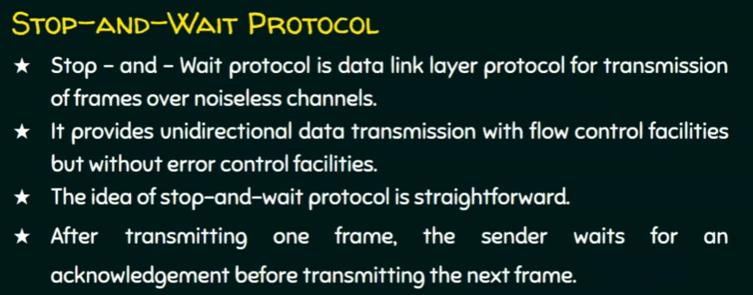
Stop-and-wait

Slide 6
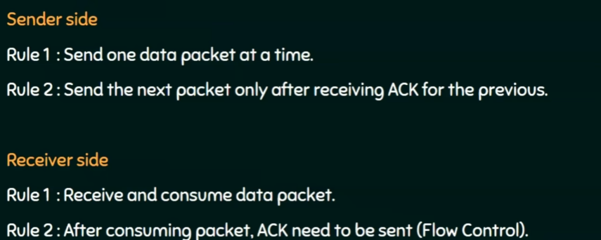
Stop-and-wait - Rules

Slide 7
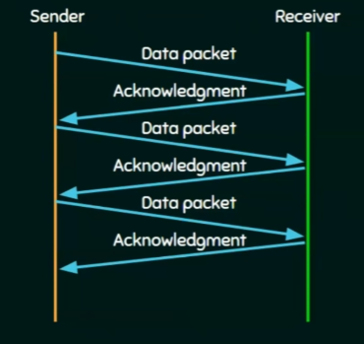
Stop-and-wait - Rules

Slide 8
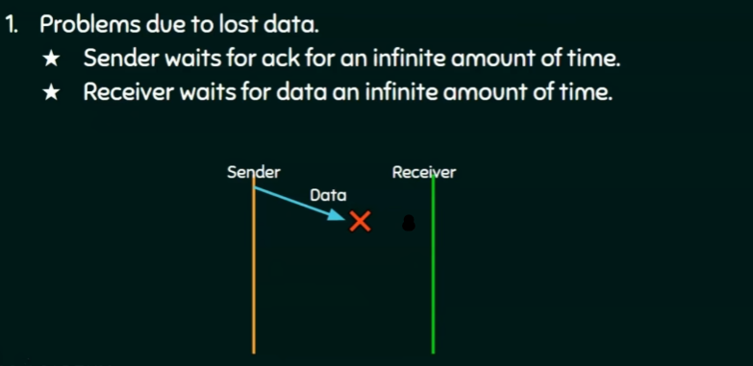
Stop-and-wait - Problems

Slide 9
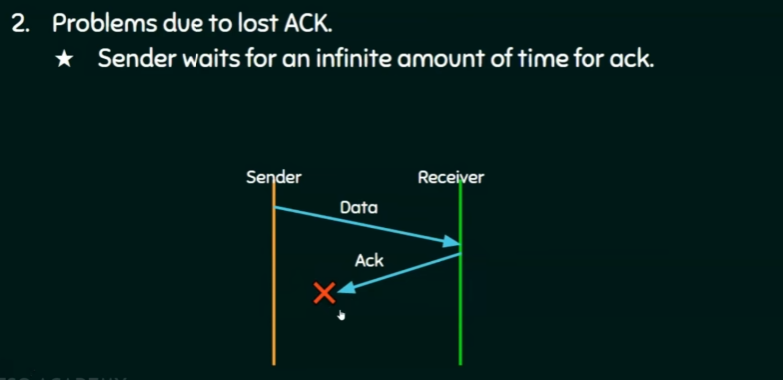
Stop-and-wait - Problems

Slide 10
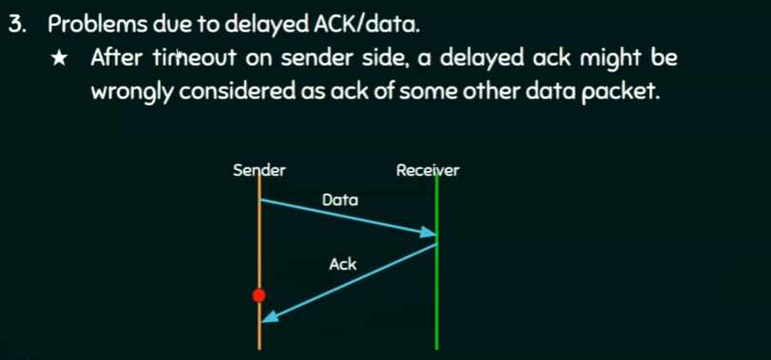
Stop-and-wait - Problems
Ack was meant to received at this point, but it got delayed

Slide 11
Noisy Channel Protocols

Slide 12
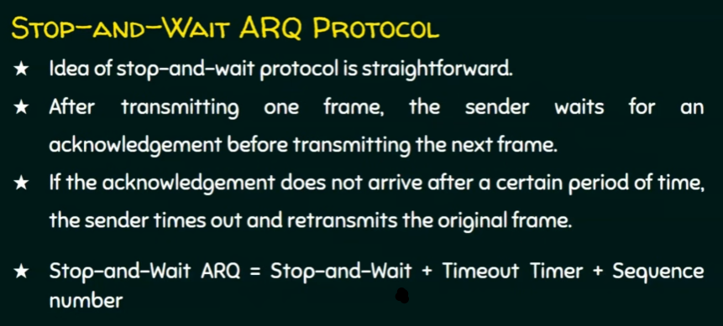
Stop-and-wait ARQ Protocol

Slide 13
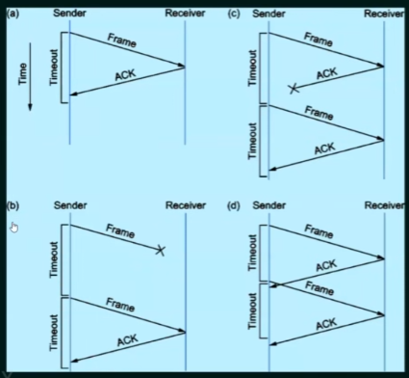
Stop-and-wait ARQ Protocol (4 Scenarios)
(b) Original Frame is lost,
Sender Retransmits the data.
(a)Ack received before timeout expiration

Slide 14
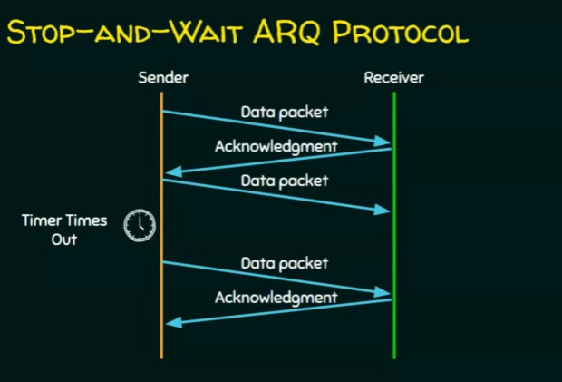
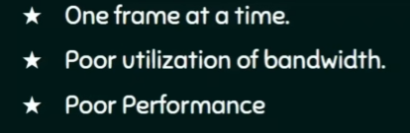
Sliding Window Protocol
Drawbacks of Stop & Wait

Slide 15
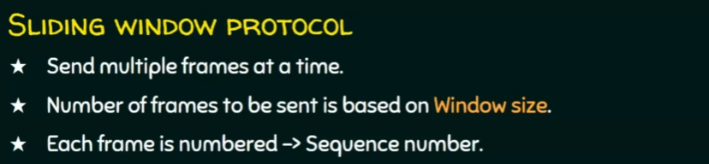
Sliding Window Protocol

Slide 16
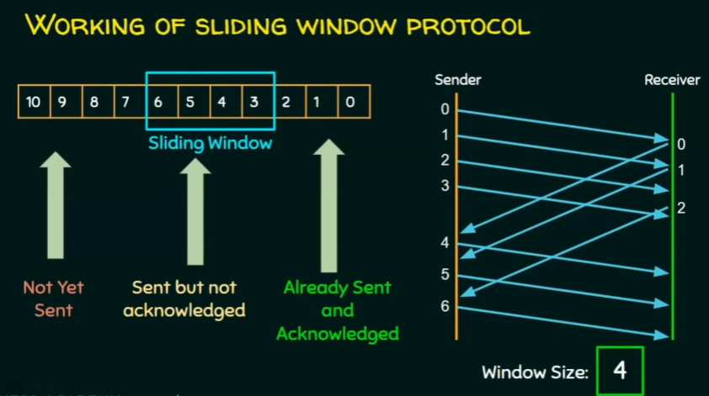
Sliding Window Protocol
4 Frames can be sent before expecting an acknowledgment, which is advantage over the Stop-and-wait protocol.

Slide 17
Sliding Window Protocol - Types
Go Back N ARQ
Selective Repeat ARQ

Slide 18
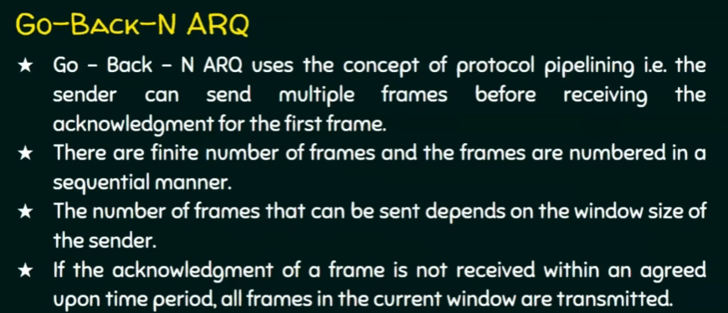
Go-Back-N-ARQ Protocol

Slide 19
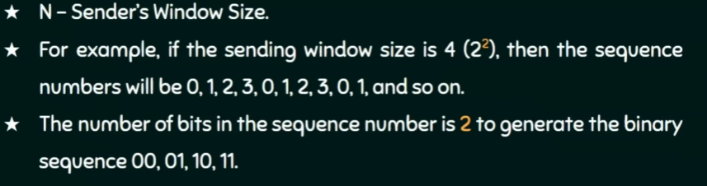
Go-Back-N-ARQ Protocol

Slide 20
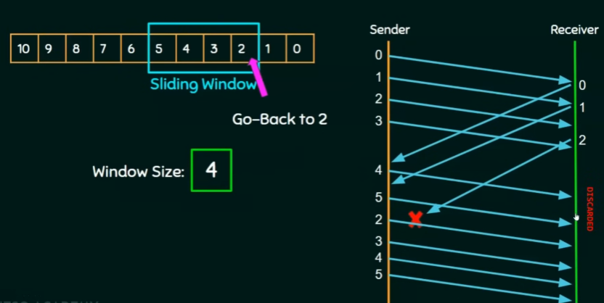
Go-Back-N-ARQ Protocol
For Frame 2 ACK is lost, & timer is expired,
now the sender will go back to 2 and re-transmit all the frames in the window currently.

Slide 21
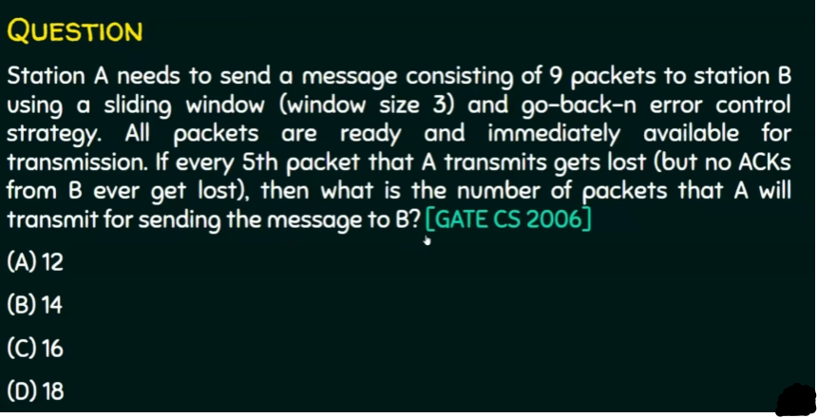
Go-Back-N-ARQ Protocol - Example

Slide 22
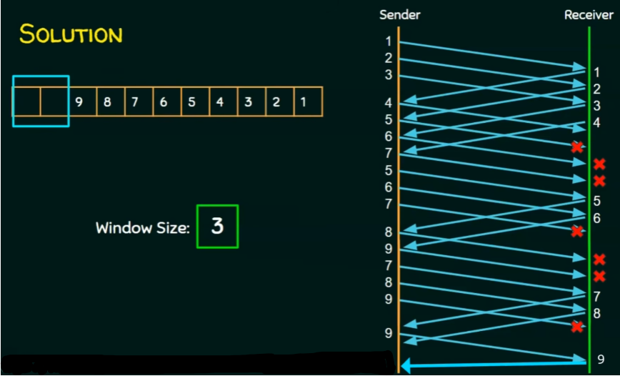

Slide 23
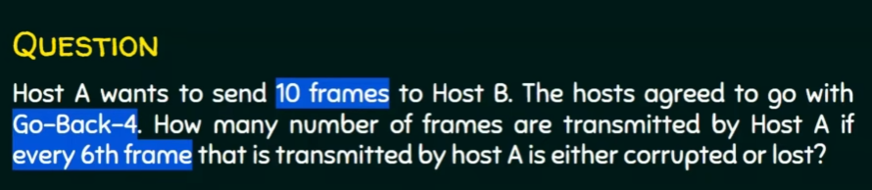

Slide 24
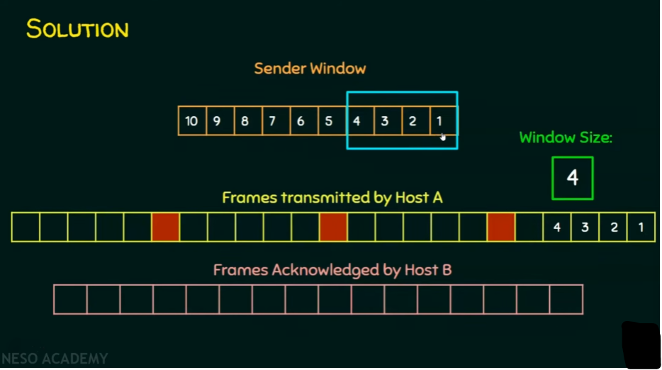

Slide 25
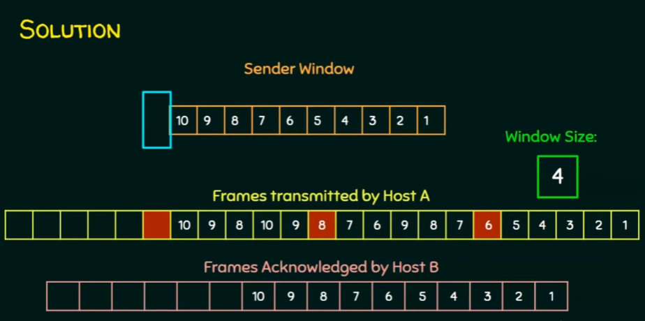
Number of Frames transmitted by the Host A are: 17

Slide 26
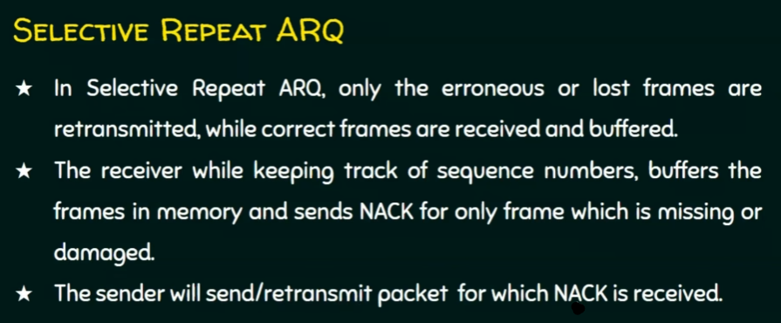
Selective-Repeat ARQ

Slide 27
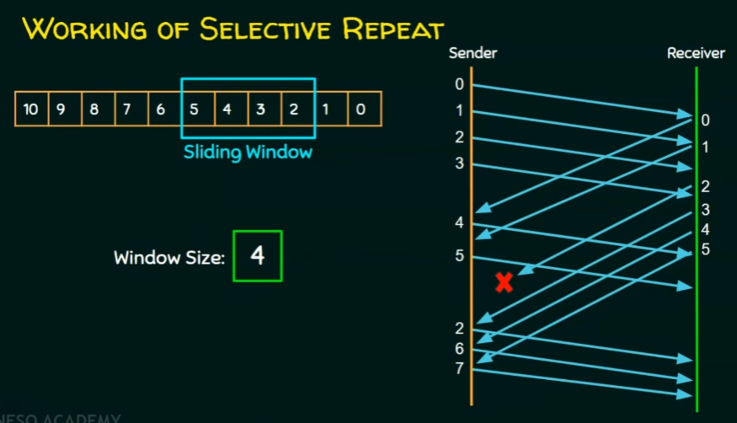
Selective-Repeat ARQ - Working
No of re-transmissions are less as compared to Go-back-N ARQ – Hence, More Efficient

Slide 28
Selective-Repeat ARQ - Working
No of re-transmissions are less as compared to Go-back-N ARQ – Hence, More Efficient

Slide 29
Go-Back-N-ARQ Protocol - Example

